Slide 1
TCP/UDP
COSC 350

Slide 2
Introduction
Internet Protocol (IP) provides “unreliable datagram service'' between hosts
Transport protocols provide end-to-end delivery between endpoints of a connection; e.g., processes or programs
User Datagram Protocol (UDP) provides datagram service
Transmission Control Protocol (TCP) provides reliable data delivery

Slide 3
User Datagram Protocol
UDP uses datagrams to deliver messages between applications or processes on host computers
“Best effort'' delivery – not responsible for lost, out-of-order, or duplicate packets
Checksum (optionally) guarantees integrity of data
For generality, endpoints of UDP are called protocol ports or ports
Each UDP data transmission identifies the internet address and port number of the destination and the source of the message
Destination port and source port may be different
Commonly used for supporting real-time or delay-sensitive /loss-tolerant services over IP datagram

Slide 4
UDP and TCP/IP layering
Transport protocols use IP to provide data delivery for application protocols
Application
Transport UDP, TCP
Internet
Network interface
Hardware

Slide 5
UDP headers
UDP datagrams have a header that follows the hardware and IP headers:
UDP header is very simple:
Port numbers
Message length
Checksum
Hardware
IP
UDP
Data
UDP source port
UDP destination port
UDP message length
UDP checksum
Data

Slide 6
Selecting UDP port numbers
Communicating computers must agree on a port number
“Server'' opens selected port and waits for incoming messages
“Client'' selects local port and sends message to selected port
Services provided by many computers use reserved, well-known port numbers:
ECHO
DISCARD
NTP
Other services use dynamically assigned port numbers

Slide 7
Well-known port numbers
Port
Name
Description
7
echo
Echo input back to sender
9
discard
Discard input
11
systat
System statistics
13
daytime
Time of day (ASCII)
17
quote
Quote of the day
19
chargen
Character generator
37
time
System time (seconds since 1970)
53
domain
DNS
69
tftp
Trivial File Transfer Protocol (TFTP)
123
ntp
Network Time Protocol (NTP)
161
snmp
Simple Network Management Protocol (SNMP)

Slide 8
TCP
Transmission Control Protocol (TCP) is most widely used transport protocol
Provides reliable data delivery by using IP unreliable datagram delivery
Compensates for loss, delay, duplication and similar problems in Internet components
Reliable delivery is high-level, familiar model for construction of applications

Slide 9
Features of TCP
Connection oriented: Application requests connection to destination and then uses connection to deliver data to transfer data
Point-to-point: A TCP connection has two endpoints
Reliability: TCP guarantees data will be delivered without loss, duplication or transmission errors
Full duplex: The endpoints of a TCP connection can exchange data in both directions simultaneously

Slide 10
Features of TCP cont’
Stream interface: Application delivers data to TCP as a continuous stream, with no record boundaries; TCP makes no guarantees that data will be received in same blocks as transmitted
Reliable connection startup: Three-way handshake guarantees reliable, synchronized startup between endpoints
Graceful connection shutdown: TCP guarantees delivery of all data after endpoint shutdown by application

Slide 11
Using IP for data delivery
TCP uses IP for data delivery (like UDP)
Endpoints are identified by ports (like UDP)
Allows multiple connections on each host
Ports may be associated with an application or a process
IP treats TCP like data and does not interpret any contents of the TCP message

Slide 12
TCP Detail
TCP travels in IP datagrams
Internet routers only look at IP header to forward datagrams
TCP at destination interprets TCP messages

Slide 13
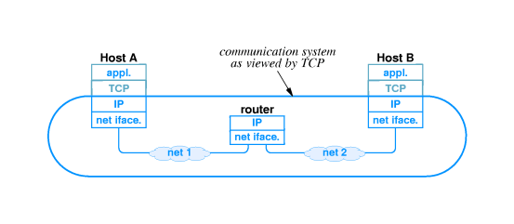

Slide 14
TCP and reliable delivery
TCP uses many techniques described earlier to provide reliable delivery
Recovers from
Lost packets
Duplicate packets
Delayed packets
Corrupted data
Transmission speed mismatches
Congestion
System reboots

Slide 15
Lost packets
TCP uses positive acknowledgment with retransmission to achieve reliable data delivery
Recipient sends acknowledgment control messages (ACK) to sender to verify successful receipt of data
Sender sets timer when data transmitted; if timer expires before acknowledgment arrives, sender retransmits (with new timer)

Slide 16
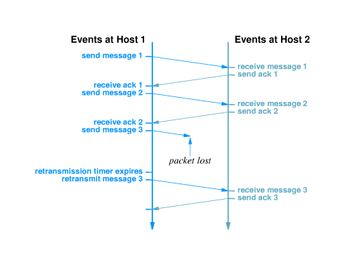
Lost packets con’t

Slide 17
TCP segments and sequence numbers
Application delivers arbitrarily large chunks of data to TCP as a``stream''
TCP breaks this data into segments, each of which fits into an IP datagram
Original stream is numbered by bytes
Segment contains sequence number of data bytes

Slide 18
Acknowledgments
Receiver sends segment with sequence number of acknowledged data (not segments)
One ACK can acknowledge many segments

Slide 19
Setting the timeout
Inappropriate timeout can cause poor performance:
Too long - sender waits longer than necessary before retransmitting
Too short - sender generates unnecessary traffic
Timeout must be different for each connection and set dynamically
Host on same LAN should have shorter timeout than host 20 hops away
Delivery time across internet may change over time; timeout must accommodate changes

Slide 20
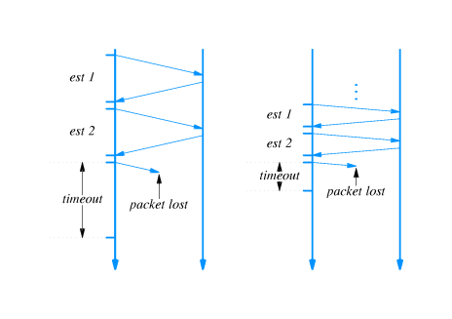
RTOs for different network delays

Slide 21
Picking a timeout value
Timeout should be based on round trip time (RTT)
Sender can't know RTT of any packet before transmission
Sender picks retransmission timeout (RTO) based on previous RTTs
Specific method is called adaptive retransmission algorithm

Slide 22
Measuring RTT
RTT measured by observing difference between time of transmission and arrival of acknowledgment
However - acknowledgments carry no information about which packet is acknowledged
Sender cannot determine whether acknowledgment is from original transmission or retransmission
Choosing original transmission overestimates RTT
Choosing retransmission underestimates RTT

Slide 23
TCP sliding window
TCP uses sliding window for flow control
Receiver specifies window
Called window advertisement
Specifies which bytes in the data stream can be sent
Carried in segment along with ACK
Sender can transmit any bytes, in any size segment, between last acknowledged byte and within window size

Slide 24
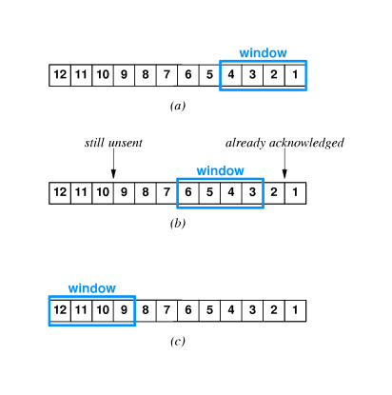

Slide 25
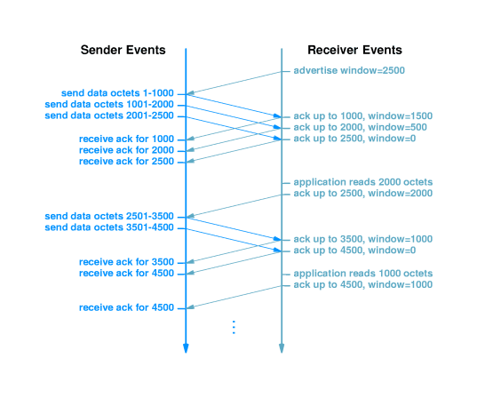
Sliding window with acknowledgments

Slide 26
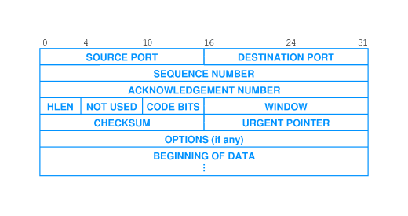
TCP segment format
TCP segment has header containing:
Same header format used in both directions
Segment can carry both data and acknowledgment

Slide 27
Three-way handshake
TCP uses three-way handshake for reliable connection establishment and termination
Host 1 sends segment with SYN bit set and random sequence number
Host 2 responds with segment with SYN bit set, acknowledgment to Host 1 and random sequence number
Host 1 responds with acknowledgment
TCP will retransmit lost segments
Random sequence numbers ensure synchronization between endpoints

Slide 28


Three-way handshake cont’
Server
Client
Connection Request (SYN=1, seq=client_num)
Connection Granted (SYN=1, seq=server_num,
Ack = client_num+1)
Ack (SYN=0, seq=client_num+1, ack=server_num+1)
Time

Slide 29
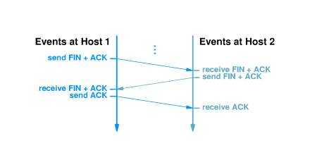
Closing a connection

Slide 31
Congestion control
Excessive traffic can cause packet loss
Transport protocols respond with retransmission
Excessive retransmission can cause congestion collapse
TCP interprets packet loss as an indicator of congestion
Sender uses TCP congestion control and slows transmission of packets
Sends single packet
If acknowledgment returns without loss, sends two packets
When TCP sends one-half window size, rate of increase slows

Slide 32
Summary
UDP provides end-to-end best-effort message delivery
IP used for delivery to destination host
Protocol ports demultiplex to destination application
TCP provides end-to-end reliable bytestream delivery
IP used for delivery to destination host
Protocol ports demultiplex to destination application
Additional techniques develop reliable delivery from IP messages
Positive acknowledgment with retransmission
Sequence numbers detect missing, duplicate and out-of-order data
Sliding window flow control
Three-way handshake
Congestion control

